Slide 1







Slide 2
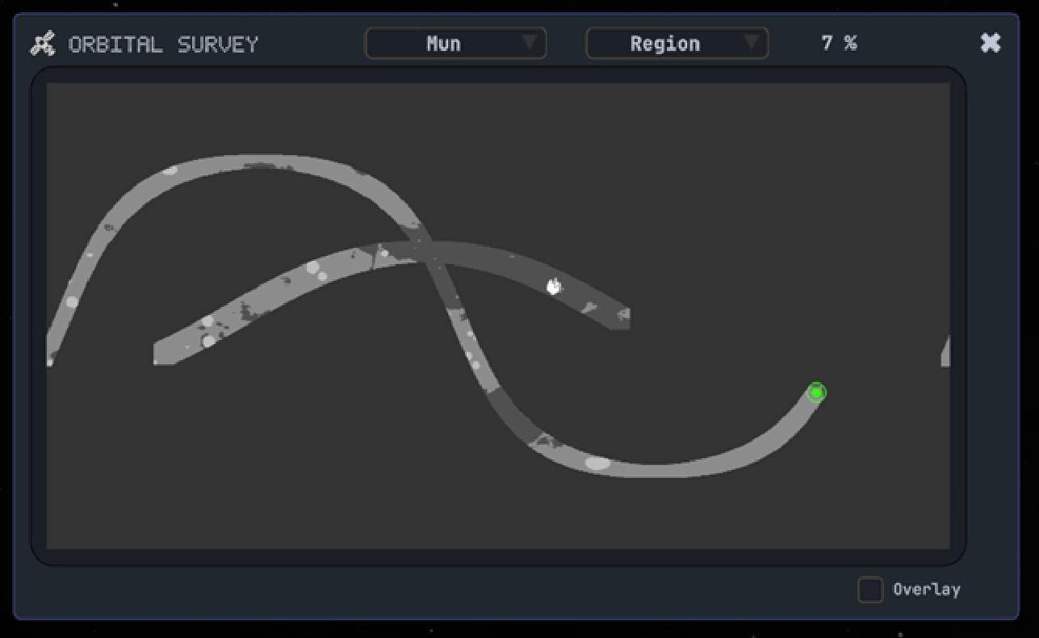




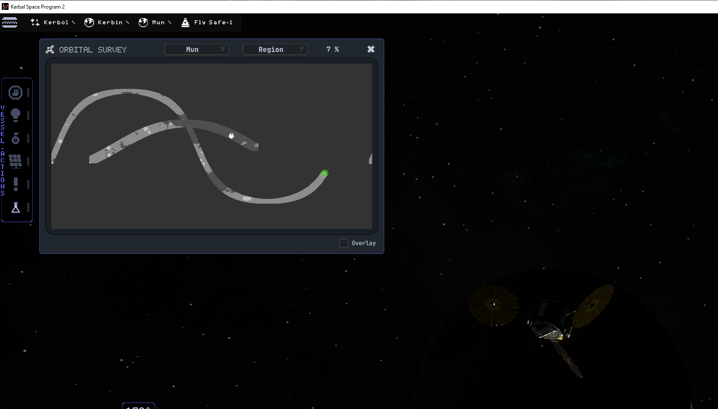
Settings
Overlay
≡
Big map
OVL
Fly Safe-1
BIG
Fly Safe-2
VES
ORB
Fly Safe -1
GEO
Show vessel locations
1.0
LAT: 45°20’21’’
LON: 45°20’21’’
+
Footer
+
-
Legend
-
1.0
VSL
LGD
LEG
LCK
LEG
VES
BIG
<a href="https://www.freepik.com/icon/settings_425734">Icon by Freepik</a>

